Slide 1


Abstraction and Interface in Java
KVS CHARAN(T1735)
A Quest Global Company

Slide 2
What is Abstraction in Java?
In Java, abstraction is achieved by interfaces and abstract classes. We can achieve 100% abstraction using interfaces.
Data Abstraction may also be defined as the process of identifying only the required characteristics of an object ignoring the irrelevant details.
The properties and behaviors of an object differentiate it from other objects of similar type and also help in grouping the objects.
Java Abstract classes and Java Abstract methods
An abstract class is a class that is declared with an abstract keyword.
An abstract method is a method that is declared without implementation.
An abstract class may or may not have all abstract methods. Some of them can be concrete methods
A abstract method must always be redefined in the subclass, thus making overriding compulsory or making the subclass itself abstract.
Any class that contains one or more abstract methods must also be declared with an abstract keyword.
There can be no object of an abstract class. That is, an abstract class can not be directly instantiated with the new operator.
An abstract class can have parameterized constructors and the default constructor is always present in an abstract class.

Slide 3
Uses of Abstraction
Reduces Complexity: By hiding implementation details, abstraction makes the system easier to understand.
Increases Flexibility: Abstract classes and interfaces provide a common structure that can be extended or implemented in various ways.
Improves Maintainability: Changes to the internal implementation do not affect the code that relies on the abstraction.
Abstraction in Java is a powerful technique to define clear, high-level interfaces while hiding the complexity of implementation.
It can be implemented using abstract classes and interfaces, making code more modular, flexible, and maintainable.

Slide 4
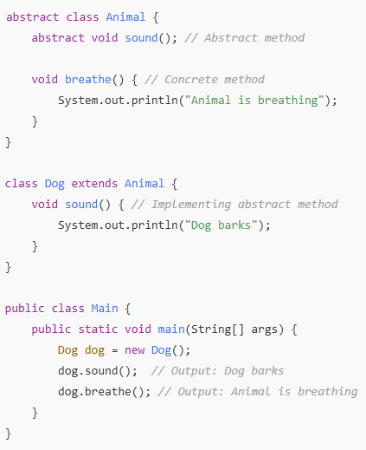
Output: Dog barks
Animal is breathing

Slide 5
What is an Interface in Java?
An interface in Java is a reference type that is similar to a class, but it can only contain abstract methods and constants (fields that are public, static, and final). It cannot contain instance fields or constructors. A class that implements an interface must provide implementations for all of its methods.
An interface is purely abstract, and it defines a contract for the implementing classes.
A class can implement multiple interfaces, which allows Java to support multiple inheritance of types (unlike classes).
Methods in an interface are by default public and abstract, though since Java 8, interfaces can also have default and static methods.
The interface in Java is a mechanism to achieve abstraction. Traditionally, an interface could only have abstract methods (methods without a body) and public, static, and final variables by default.
It is used to achieve abstraction and multiple inheritances in Java. In other words, interfaces primarily define methods that other classes must implement. Java Interface also represents the IS-A relationship.
To deepen your understanding of interfaces and how they are used in modern Java applications, the Java Programming Course offers structured lessons and coding exercises to solidify your learning.
In Java, the abstract keyword applies only to classes and methods, indicating that they cannot be instantiated directly and must be implemented.

Slide 6
Uses of Interfaces in Java are mentioned below
It is used to achieve total abstraction.
Since java does not support multiple inheritances in the case of class, by using an interface it can achieve multiple inheritances.
Any class can extend only one class, but can implement multiple interfaces.
It is also used to achieve loose coupling.
Interfaces are used to implement abstraction.

Slide 7
import java.io.*;
interface In1 {
final int a = 100;
void display();
}
class TestClass implements In1 {
public void display(){
System.out.println(“Mr Majnu");
}
public static void main(String[] args)
{
TestClass t = new TestClass();
t.display();
System.out.println(t.a);
}
}
Output: Mr Majnu
100

Slide 8


Thank You

